Slide 1
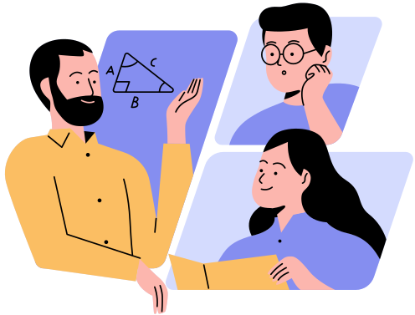
Dynamic Programming
Over SubSets (Steiner Tree)
Presented By
Soumya Swagata Biswas
Group ID: 7
Student ID: 1905093

Slide 2

d
What is a Steiner Tree
A Steiner Tree is a generalization of the Minimum Spanning Tree (MST).
A Steiner Tree allows for additional “vertices” which allows us to lessen the cost of path

Slide 3
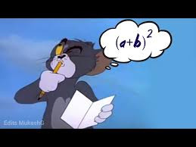

Intuitive Simulation
of the Problem

Slide 4
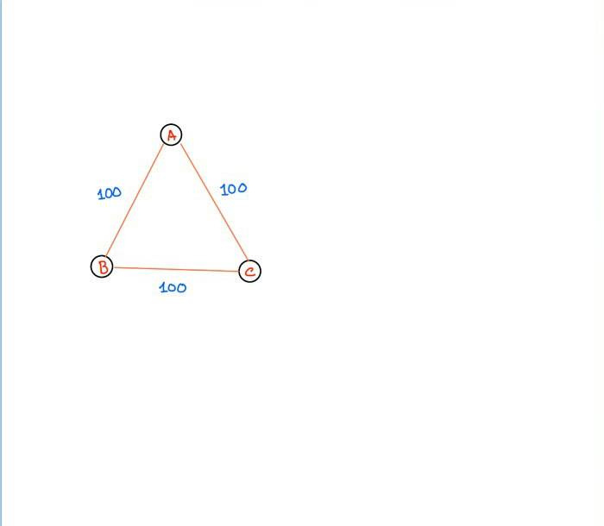

How MST Works
We have 3 cities with train lines between them, we need to go to all the cities with minimum cost

Slide 5
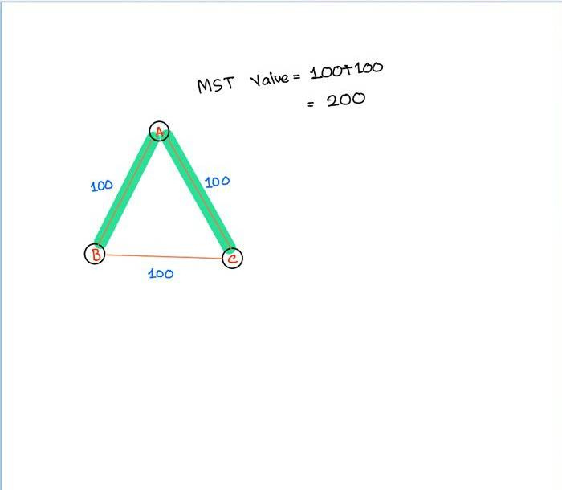
How MST works
The Min distance the train has to go through is 200 to go to all the cities

Slide 6
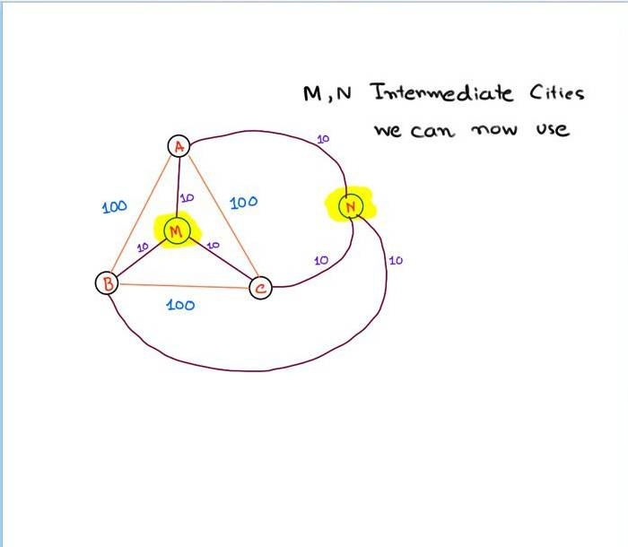
Steiner Tree Idea
Suppose, We now go through two sub-cities
These cities are M and N, we can use them if we want now

Slide 7
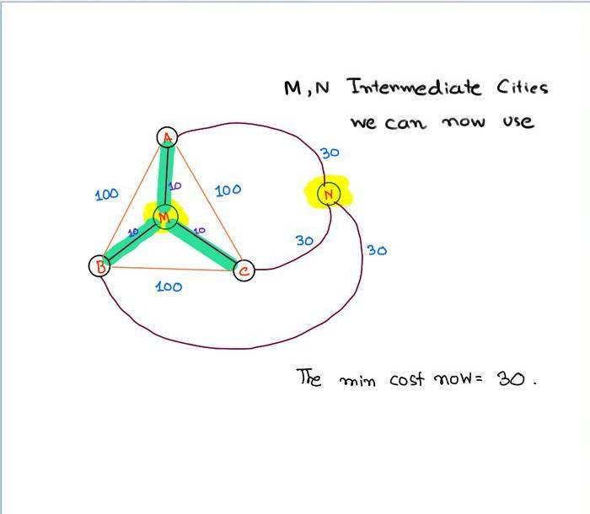
Steiner Tree Idea
We can now use M to get a more effcient path between all the Main Cities

Slide 8
Formal DEfinition of Steiner Tree
We have a graph, let’s call it G
Let V(G) be all the vertices of G, total n
We select K vertices where K<n, we call these terminal vertices

Slide 9
Formal DEfinition of Steiner Tree (Cont.)
A steiner tree C is a connected subgraph H of G
H contains all K vertices (Terminal Vectices)
The rest of the vertices of H are called Steiner Vertices, formally V(H)/K
The Minimum Steiner Tree Problem aims to minimize the weight of H

Slide 10
WHy Steiner TRee Minimum WEight is a NP-HARD problem
Put simply, as the size of the graph increaase, so does our choice for steiner vertices. Because of the exponential choices of Steiner vertices, this is a NP-Hard problem

Slide 11

Some Terms before we go forward
dist(u,v) = Min distance between vertice u and v (Using Dijkstra)
G(V) = Initial Graph G with all V vertices
K= Set of all the terminal vertices
D = Subset of the terminal vertices
H = The steiner tree, containing all K + none or any of Steiner Vertices

Slide 12
Trivial Cases (1)
If K=1, then the answer is trivial with a graph only containing K
U

Slide 13
Trivial Cases (2)
If K=2, then the graph is simply the minimum distance between these two vertices
U
V

Slide 14

Trivial Cases (3)
If K=V, this means the steiner tree has all the vertices of G.
This is simply the Minimum Spanning Tree Problem, since the Set of Steiner vertices will be V(G)/V =

Slide 15
Working through an Example
Now we will go through the graph below to find out the minimum weight steiner tree

Slide 16
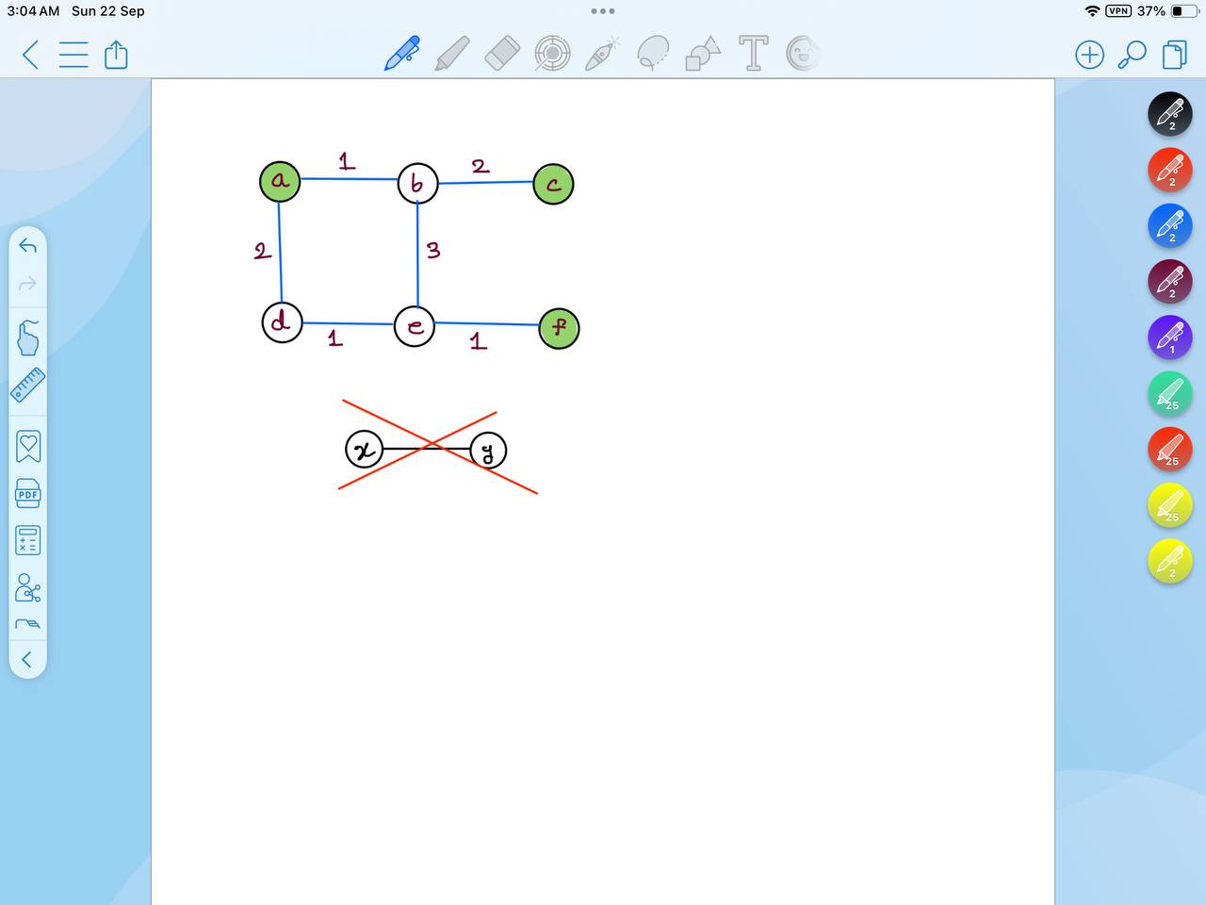
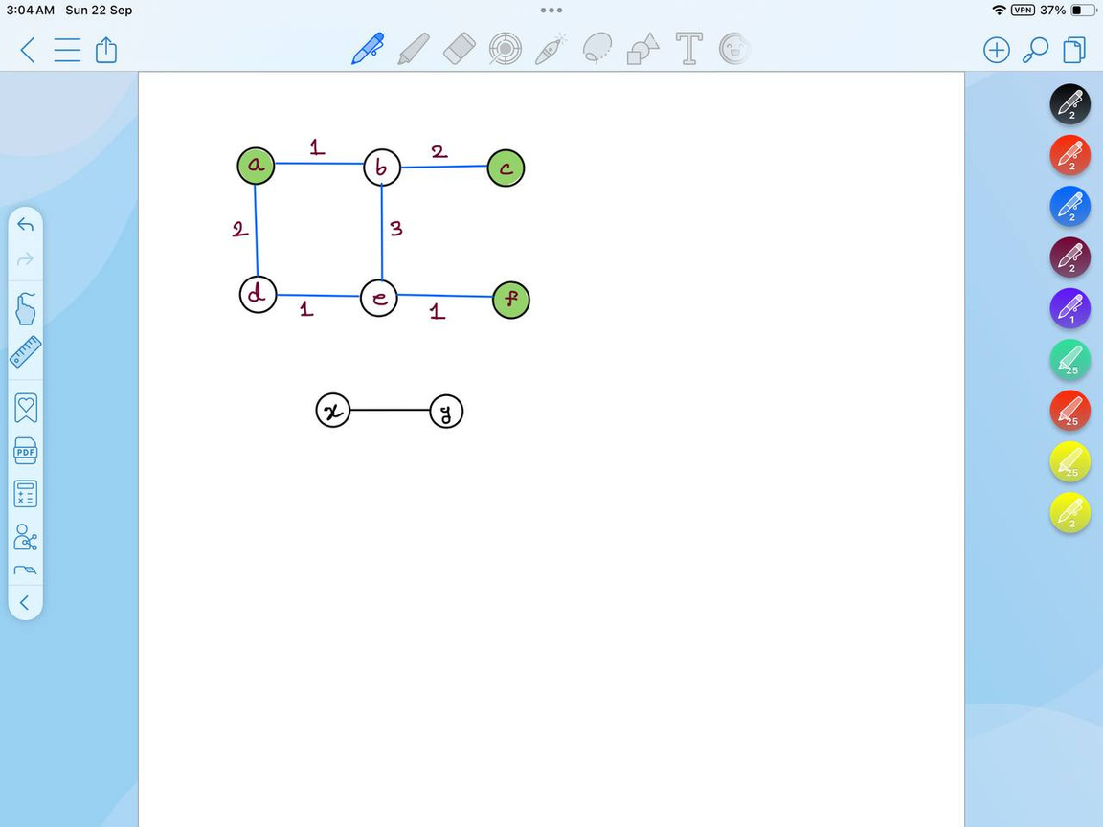
PreProcessing (1)
First we check if all our Terminal vertices K are in the same connected component
If so, we only work with that component and discard the rest

Slide 17
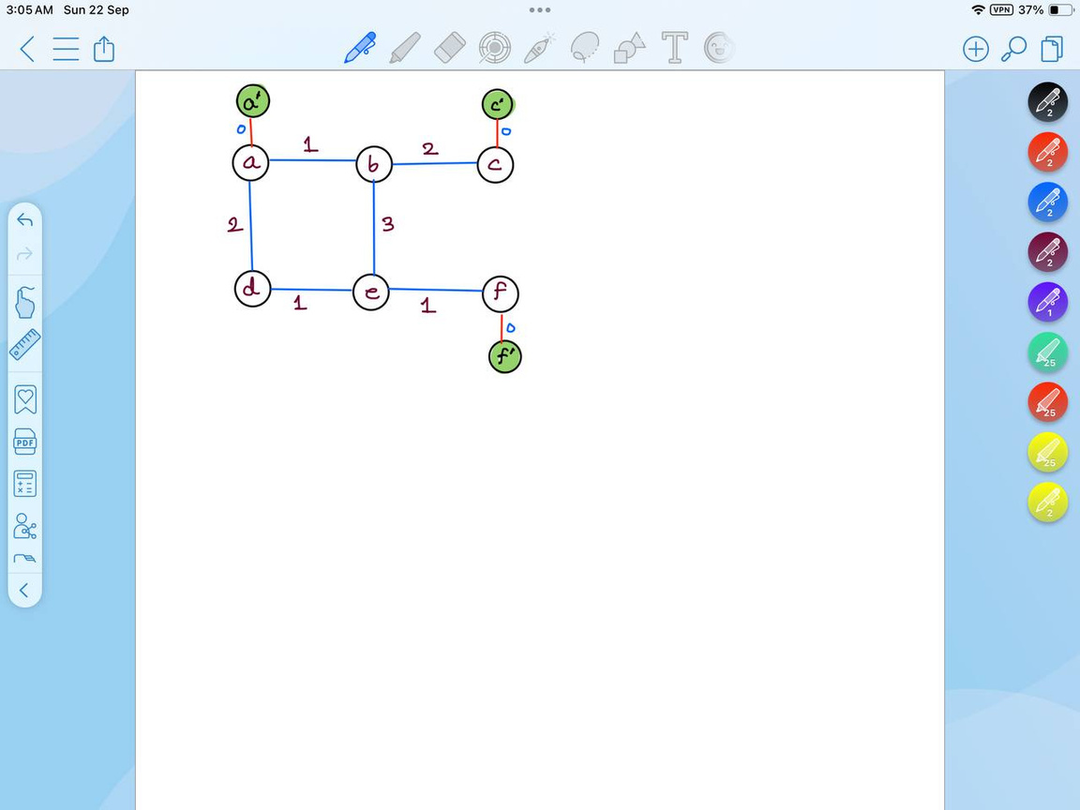
PreProcessing (2)
We make sure that the terminal vertices have a degree of only 1, with no connection to another terminal vertice
For this, we add dummy vectices with the terminal
After that, we connect them with edge cost 0.
These Dummy vertices become the new terminals

Slide 18
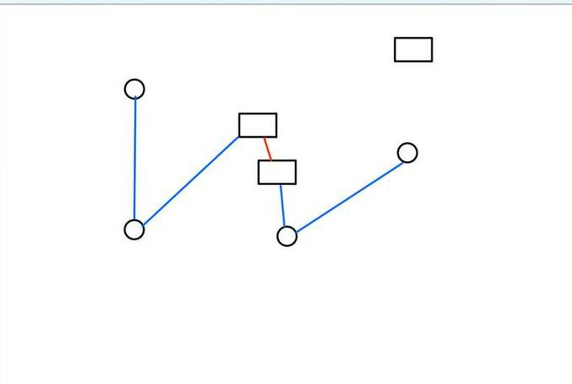
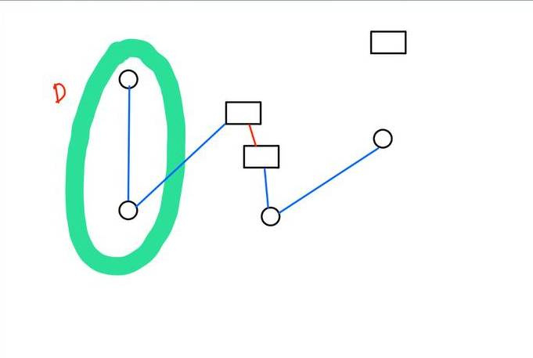
Intuition behind DP approach
We take D as the subset of the terminals

Slide 19
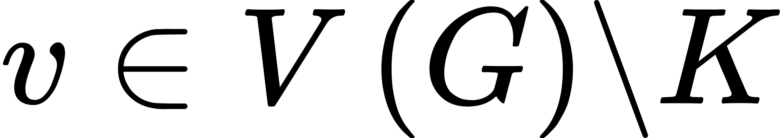
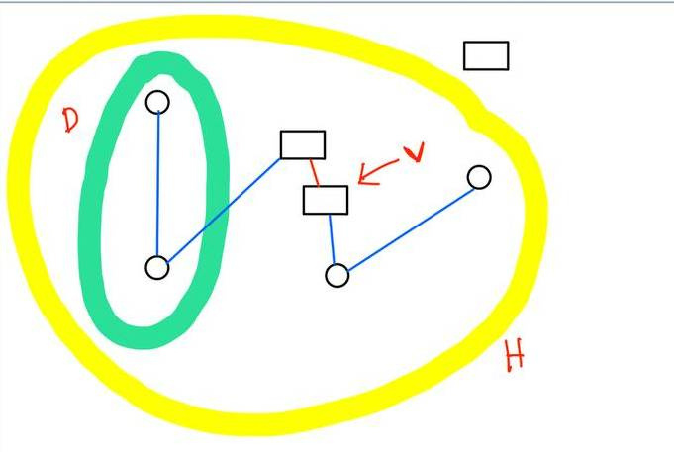
Intuition behind DP approach
We take D as the subset of the terminals
For every , we consider an optimum steiner tree H

Slide 20
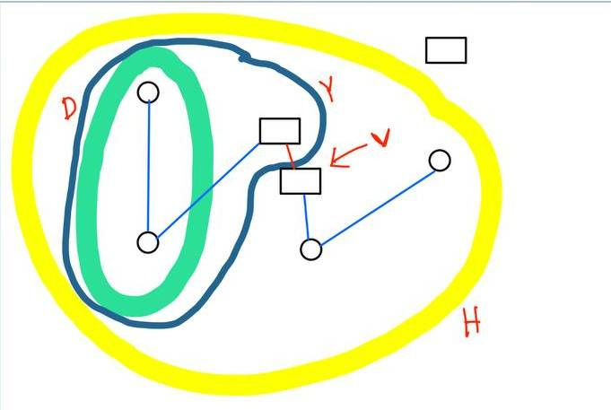
Intuition behind DP approach
We take D as the subset of the terminals
For every , we consider an optimum steiner tree H
We assume that a subtree of H contains D, let’s call it Y

Slide 21
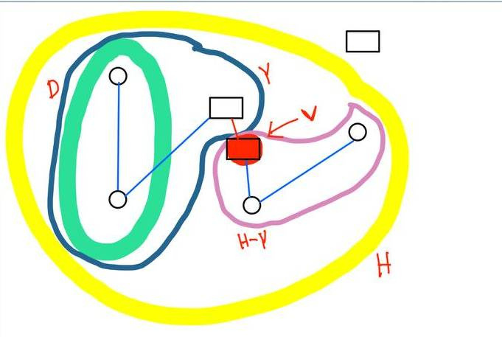
Intuition behind DP approach
We take D as the subset of the terminals
For every , we consider an optimum steiner tree H
We assume that a subtree of H contains D, let’s call it Y
We say Y is connected to H-Y by the vertex v
DP Base Case: T[{t},v] = dist(t,v) where D={t}

Slide 22
sIMULATION OF dp TABLE
First we check if all our Terminal vertices K are in the same connected component
If so, we only work with that component and discard the rest

Slide 23
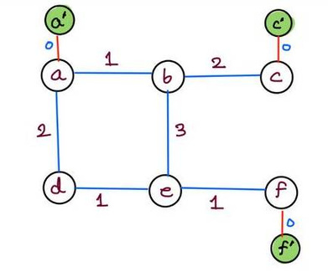
sIMULATION OF dp TABLE
The Initial DP table would be like
Terminal Subset | Ending at a’ | Ending at c’ | Ending at f’
{a’} | 0 | inf | inf
{c’} | inf | 0 | inf
{f’} | inf | inf | 0

Slide 24
sIMULATION OF dp TABLE
Considering Subset {a’,c’}
Path: a’ -> a-> b -> c -> c’ Cost: 1+2 = 3
Terminal Subset | Ending at a’ | Ending at c’ | Ending at f’
{a’} | 0 | inf | inf
{c’} | inf | 0 | inf
{f’} | inf | inf | 0
{a’,c’} | 0 | 3 | inf

Slide 25
sIMULATION OF dp TABLE
2. Considering subset {a’,f’}:
Path: a’ -> a-> d -> e -> f -> f’ Cost: 1+1+2 = 4
Terminal Subset | Ending at a’ | Ending at c’ | Ending at f’
{a’} | 0 | inf | inf
{c’} | inf | 0 | inf
{f’} | inf | inf | 0
{a’,c’} | 0 | 3 | inf
{a’,f’} | 0 | inf | 4

Slide 26
sIMULATION OF dp TABLE
3. Considering Subset {c’,f’}
Path: c’ -> c-> b -> e -> f -> f’ Cost: 2+3+1 = 6
Terminal Subset | Ending at a’ | Ending at c’ | Ending at f’
{a’} | 0 | inf | inf
{c’} | inf | 0 | inf
{f’} | inf | inf | 0
{a’,c’} | 0 | 3 | inf
{a’,f’} | 0 | inf | 4
{c’,f’} | inf | 0 | 6

Slide 27
sIMULATION OF dp TABLE
4. Considering subset {a’,c’,f’}
Path: {a’,f’} + {c’,f’} - Common edges|| Cost: 6+4-4=6
Terminal Subset | Ending at a’ | Ending at c’ | Ending at f’
{a’} | 0 | inf | inf
{c’} | inf | 0 | inf
{f’} | inf | inf | 0
{a’,c’} | 0 | 3 | inf
{a’,f’} | 0 | inf | 4
{c’,f’} | inf | 0 | 6

Slide 28
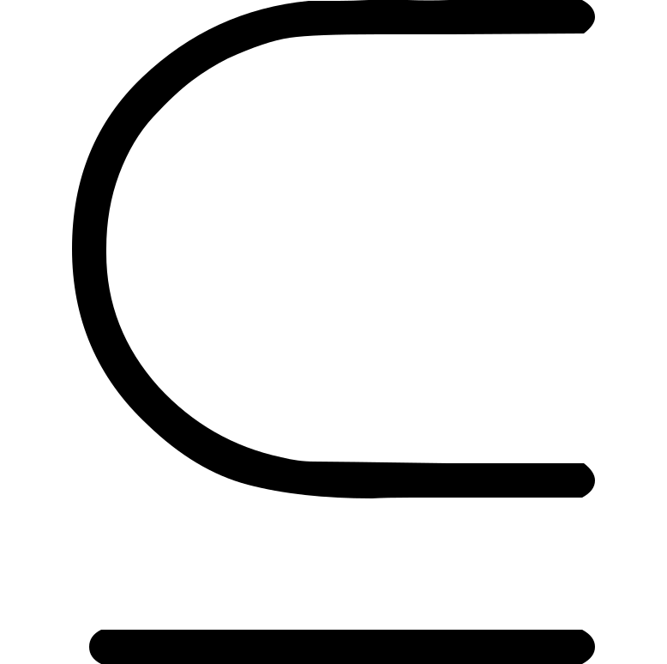

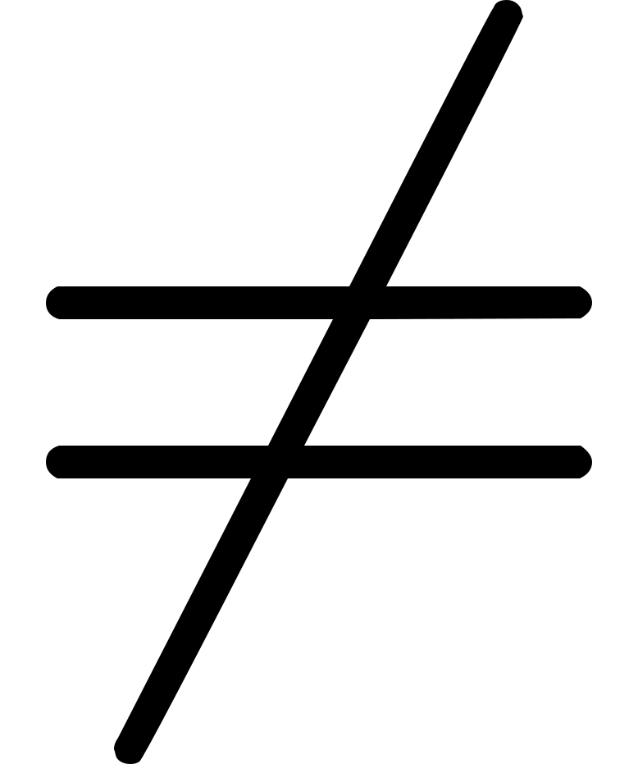
Recursive Formula Lemma
Lemma 6.2: For Every D K of size at least 2, and every
v V(G)\K, the following holds
T[D,v] = min { T[D’,u] + T[D\D’, u] + dist(v,u) }
u
V(G)/K
D’
D

Slide 29


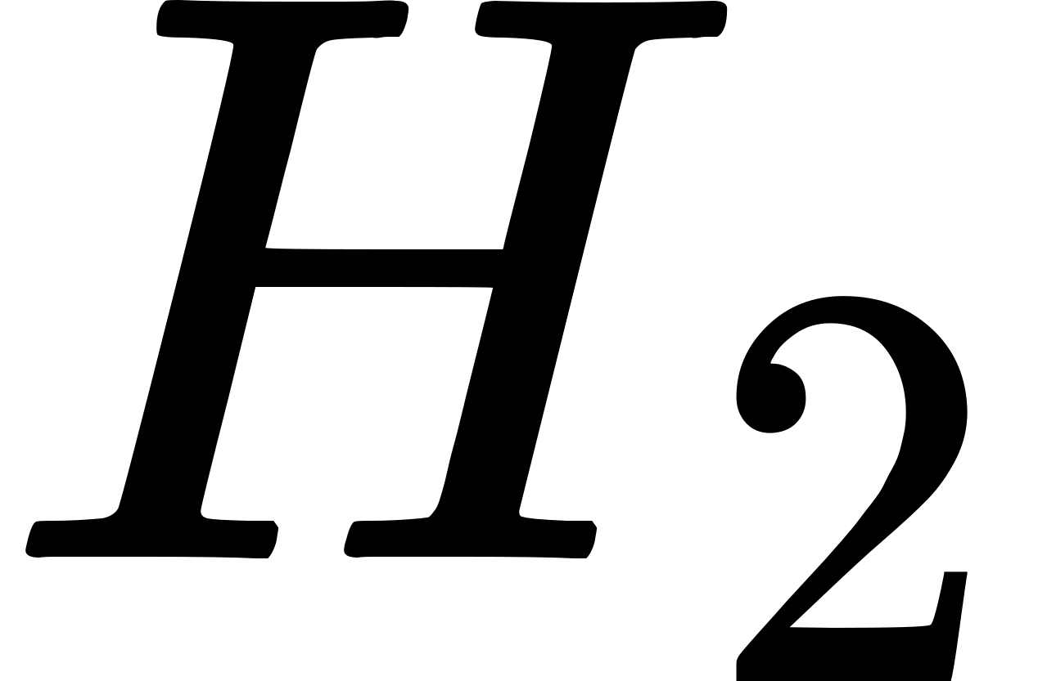
Proof
Sufficiency:
Let D’ be a subset of D which is not null
Let u V(G), then is a Steiner tree for D’ {u} in G of Min weight
Simullarly, is for the Value T[D\D’,u]
Let P be a shortest path from u->v

Slide 30


Proof
Sufficiency:
Now will be a connected subgraph
Since it includes P, it will have

Slide 31
Proof
Sufficiency:
Thus, it becomes:

Slide 32
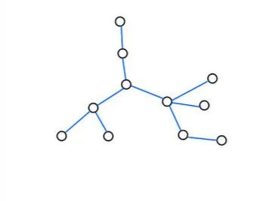
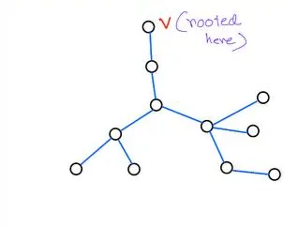
Proof
Necessity:
For this, Let’s assume a few things first
Let H be a steiner tree for D U {v}
Let us root the tree at vertex v

Slide 33

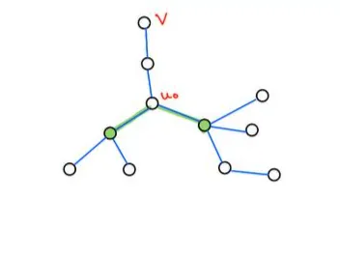
Proof
Necessity:
For this, Let’s assume a few things first
Let be a vertex of H with at least two child
Also it is the closest to v
Now this can’t be a terminal because all
terminals have only degree 1

Slide 34
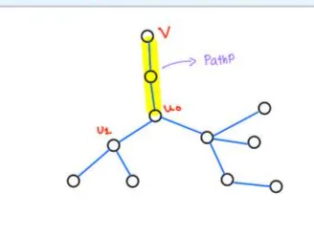
Proof
Necessity:
Now, in this graph we have
Path P between and v

Slide 35
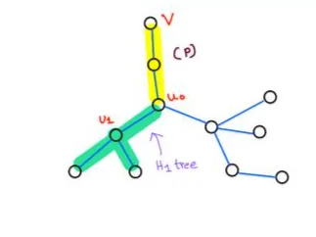

Proof
Necessity:
Now, in this graph we have
Path P between and v
subtree rooted at , with edge

Slide 36
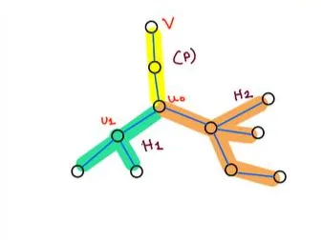
Proof
Necessity:
Now, in this graph we have
Path P between and v
subtree rooted at , with edge
consisting of the remaining edges of H

Slide 37
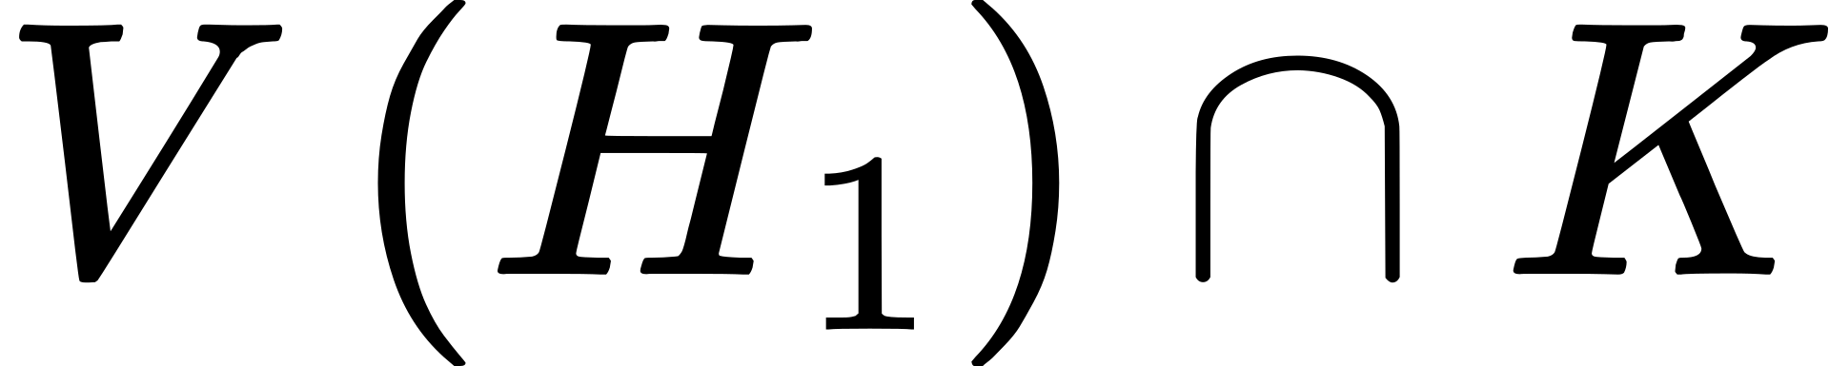
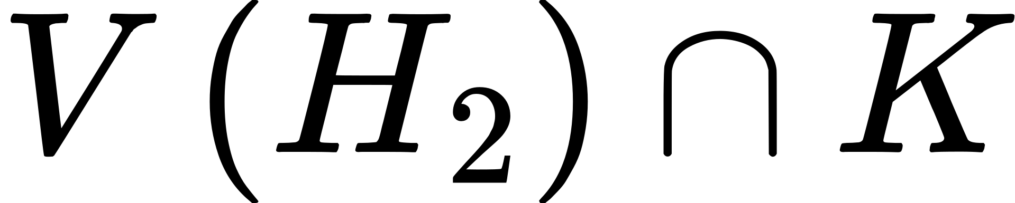
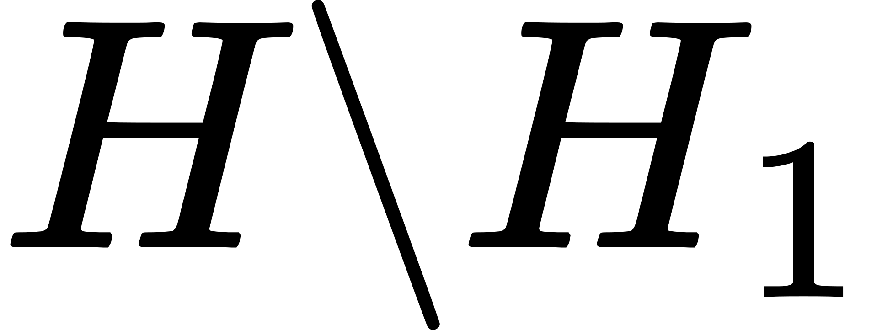
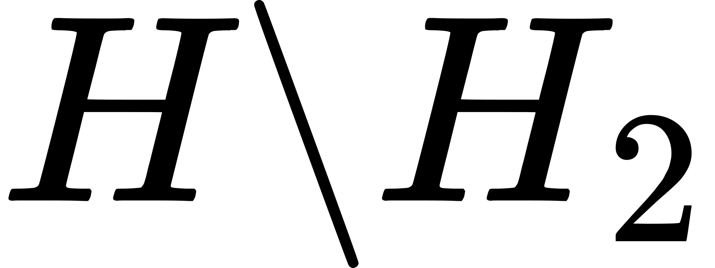
Proof
Necessity:
Let D’ = , terminals in tree
Let D/D’ = , terminals of
Since H is of min weight, is a steiner tree of D U {v}
In the same way, is also a steiner tree for D U {v}

Slide 38
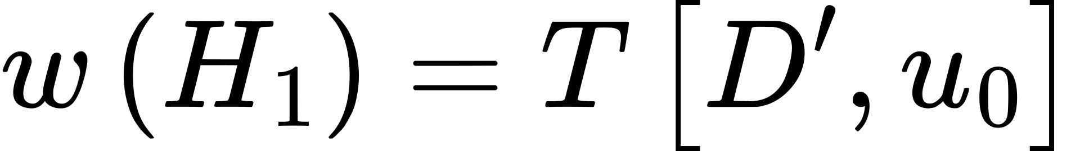
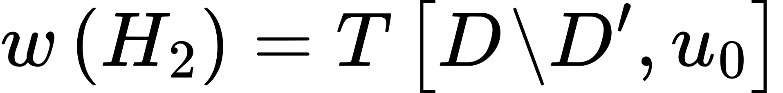
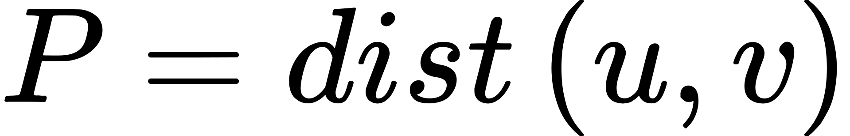
Proof
Necessity:
From optimality, it follows

Slide 39

Proof
Necessity:
Then we get

Slide 40
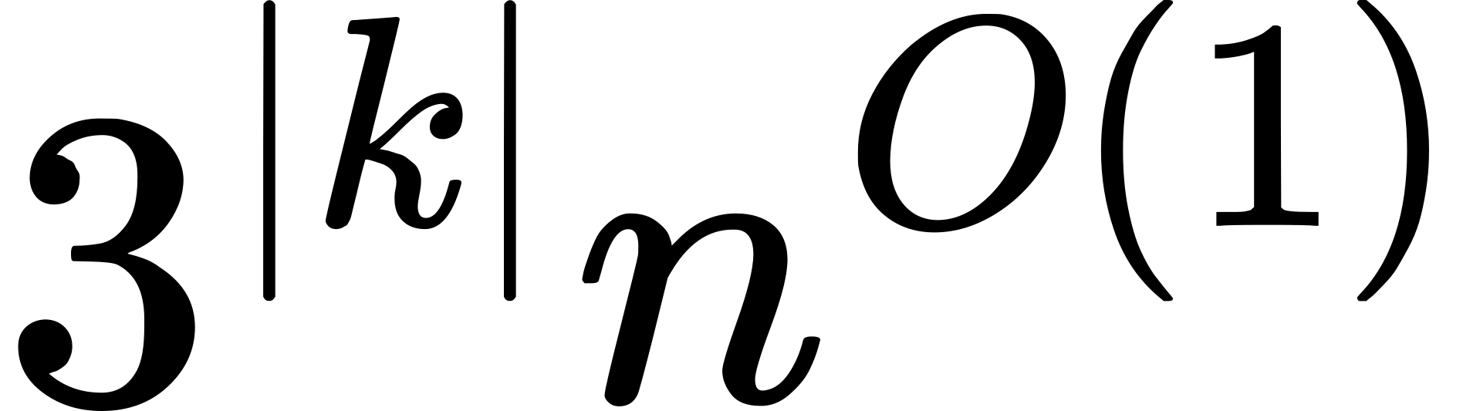
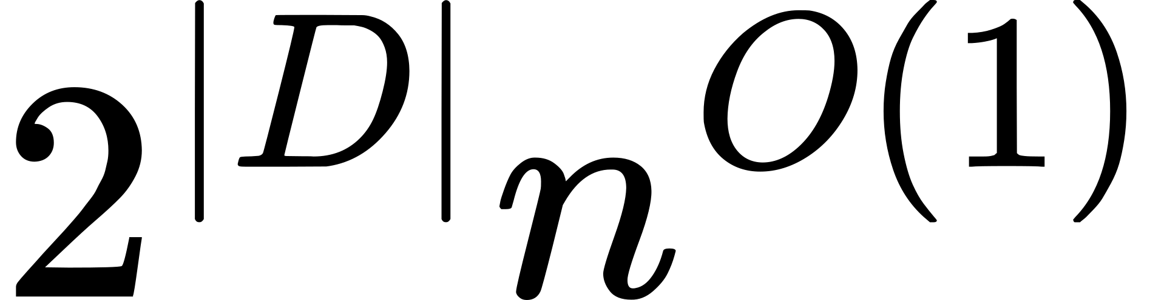
Proof
Lemma 6.3:
Steiner Tree can be solved n time
Let (G, w, K) be a preprocessed Steiner Tree
We compute all values of T[D,v] in increasing cardinality/size of D
T[D,v] can be computed in time

Slide 41
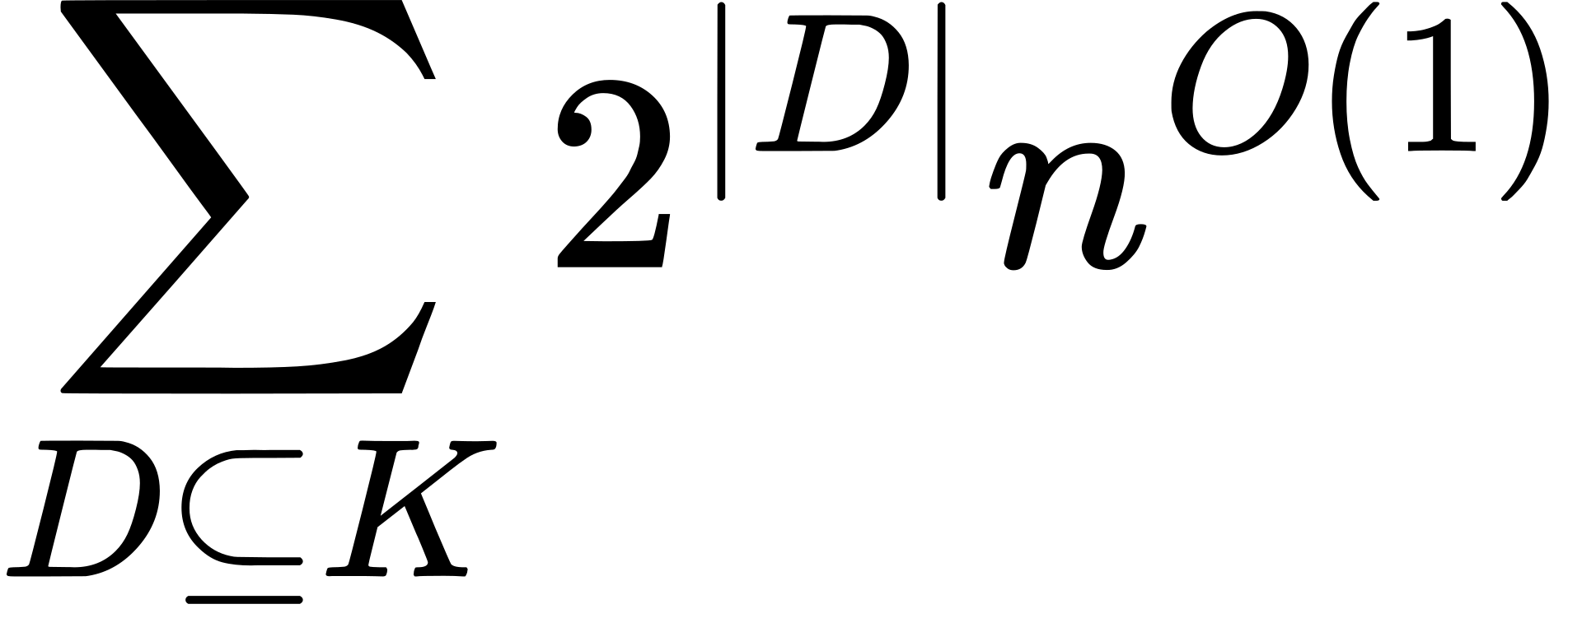
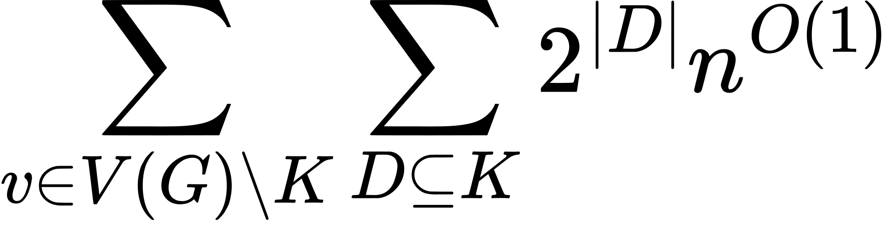
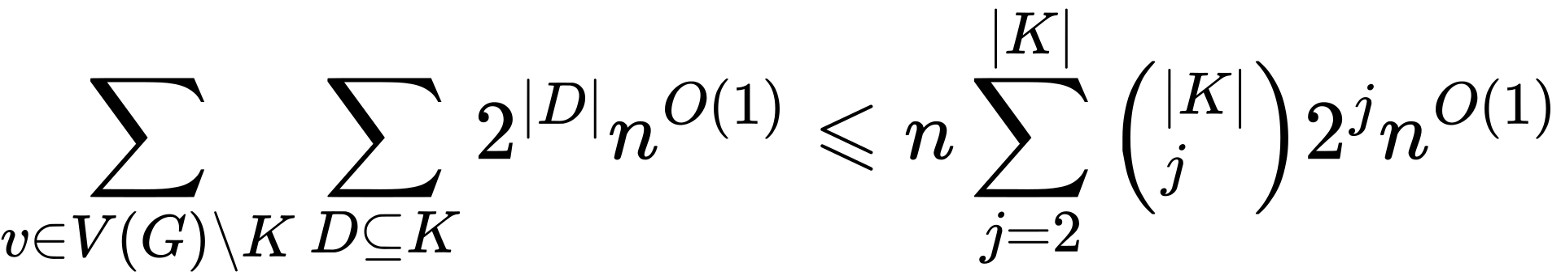
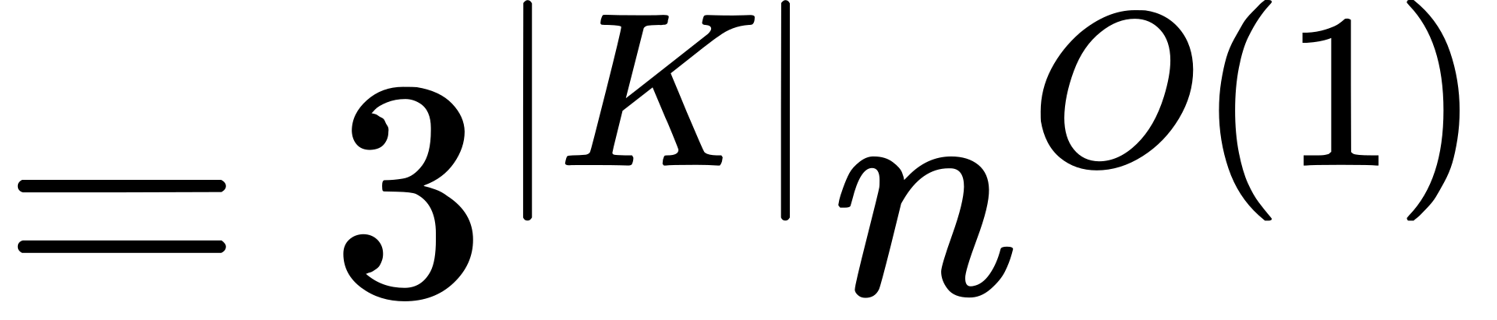
Proof
Lemma 6.3:
For all cardinality of K, we get
For all steiner vertices, we get
Finally, we can write this as

Slide 42
Thank You Everyone for Your Time
Any Questions are welcomed

